Slide 1
Health Econometrics I
Lecture 11: New Developments in Staggered Adoption Designs
November 25, 2022
HAD5744 • Alex Hoagland, Ph.D.
Notes:
Don’t forget about course evaluations. Also ask about other policies (is this second half of the lecture helpful, or would you like to see another method?) Talk about presentation slides.

Slide 2
Two Way Fixed Effects
Estimates dynamic treatment effects
Lets us pool multiple treated units potentially with differential timing of treatment (staggered adoption)
Very commonly used!

Slide 3
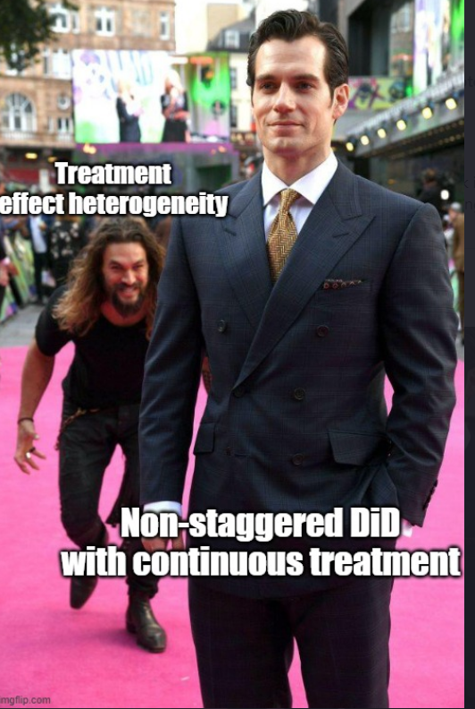
Two Way Fixed Effects
Estimates dynamic treatment effects
Lets us pool multiple treated units potentially with differential timing of treatment (staggered adoption)
Very commonly used…incorrectly!

Slide 4
Session Outline: Hour 1
Contamination in TWFE
Goodman-Bacon Decomposition
Robust Estimators
Alternative Frameworks

Slide 5
Session Outline: Hour 2
Session Outline: Hour 1
Contamination in TWFE
Goodman-Bacon Decomposition
Robust Estimators
Alternative Frameworks
Research Design
Evaluating and Creating Good Research
Notes:
Feedback on hour 2 heavily solicited – what do you think you need to bridge the gap between the methods here and the research careers you want to have?

Slide 6
Contamination in TWFE

Slide 7
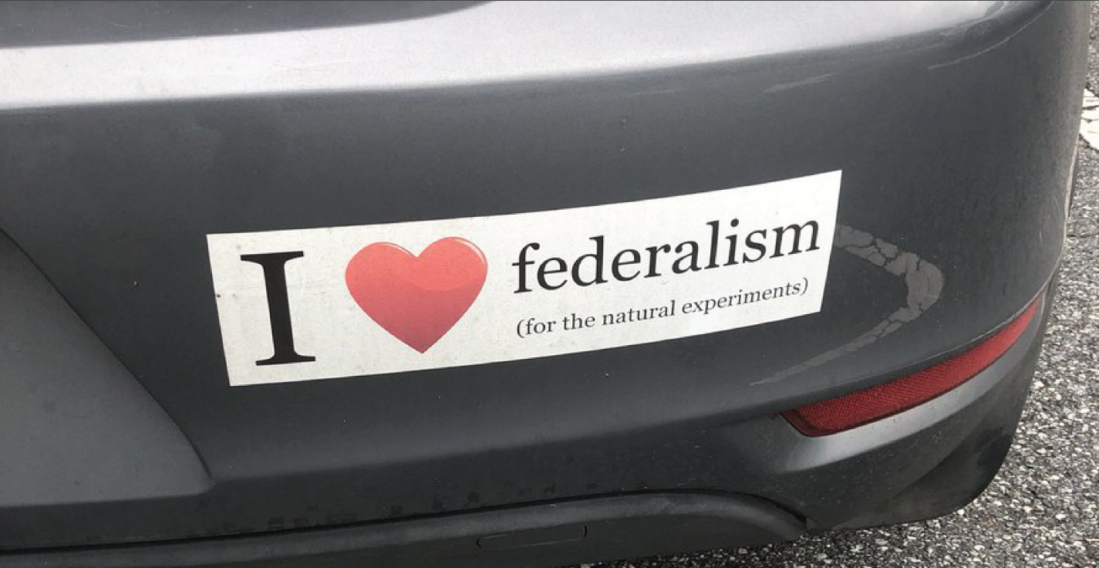
Quasi-Experimental Variation is a Two-Edged Sword
Notes:
In DiD we talked about exploiting time – double-edged sword. The tricky thing here is that with federalism, things happen slowly over time, and differently, and with anticipation, and have spillover effects, and and and and… real-world causal inference is tricky and each context is its own level of tricky

Slide 8
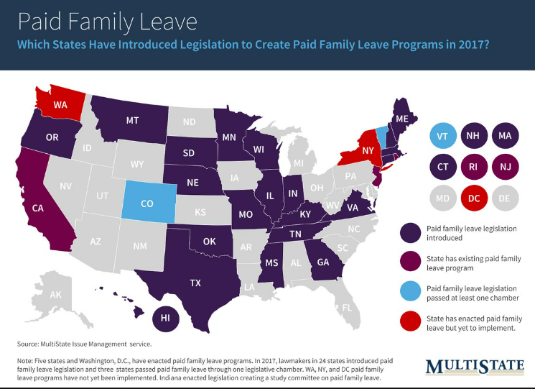
Remember: Quasi-Experimental Variation
Notes:
Each policy looks different and is enacted at different times. But we want power, right! Want to generalize and have external validity as well? These are good reasons for stacking.

Slide 9
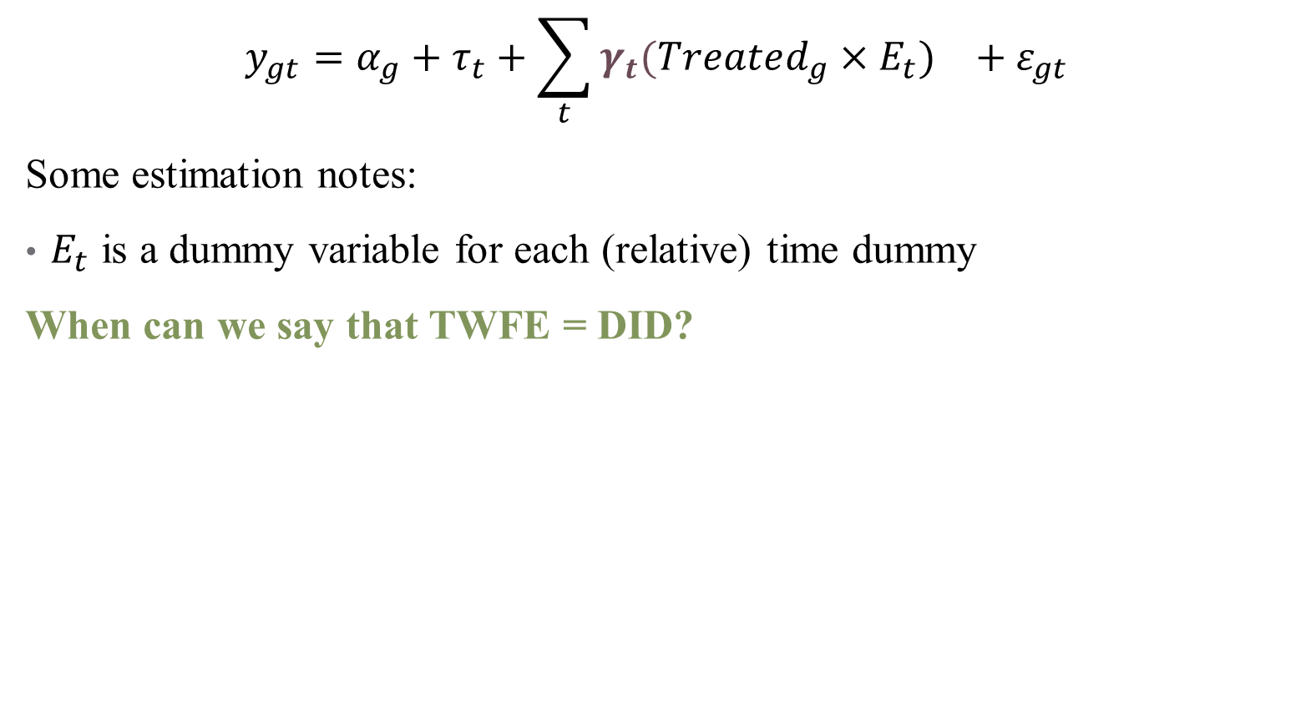
TWFE Regressions
$$y_{gt}=α_{g}+τ_{t}+{\sum_{t}{γ_{t}(Treated_{g}×E_{t}})}_{}+ε_{gt}$$
Some estimation notes:
$E_{t}$ is a dummy variable for each (relative) time dummy
When can we say that TWFE = DID?
Notes:
Here we stack so that everyone is in the treated group g (all purple, blue states)

Slide 10
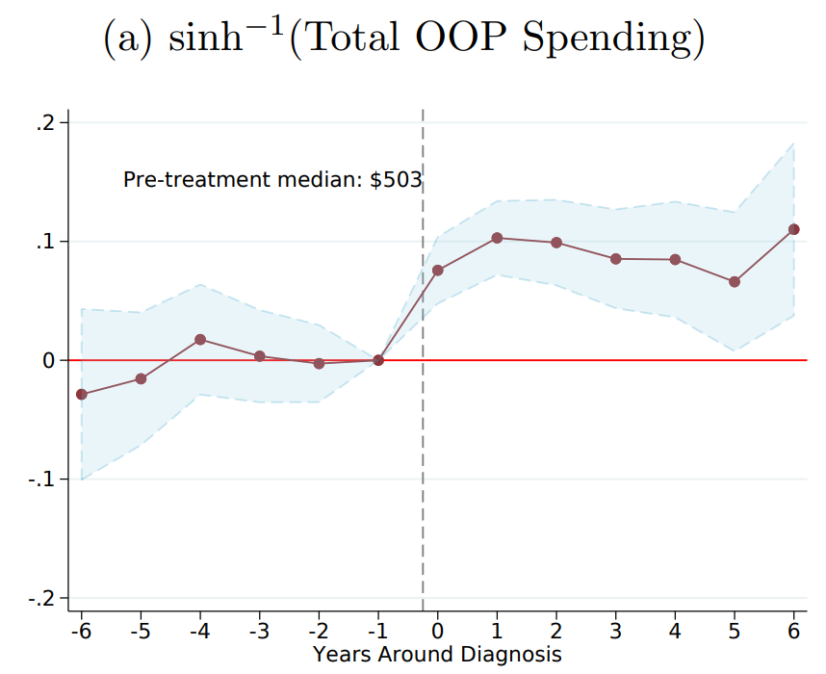
Dynamic Treatment Effects in TWFE
Notes:
This is what we hope to see when we run a TWFE – you can see why this is appealing (pre- and post-trend; tells you how long an effect sticks around, etc. )

Slide 11
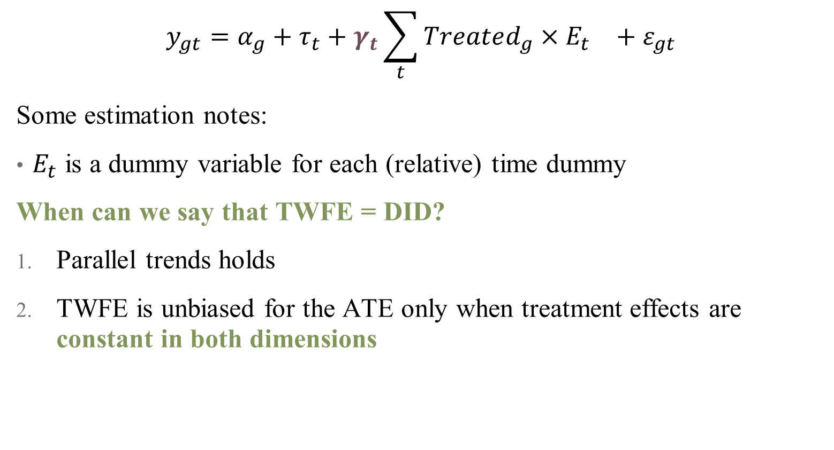
TWFE Regressions
$$y_{gt}=α_{g}+τ_{t}+{γ_{t}\sum_{t}{Treated_{g}×E_{t}}}_{}+ε_{gt}$$
Some estimation notes:
$E_{t}$ is a dummy variable for each (relative) time dummy
When can we say that TWFE = DID?
Parallel trends holds
TWFE is unbiased for the ATE only when treatment effects are constant in both dimensions
Notes:
Number 2 is frequently implausible!

Slide 12
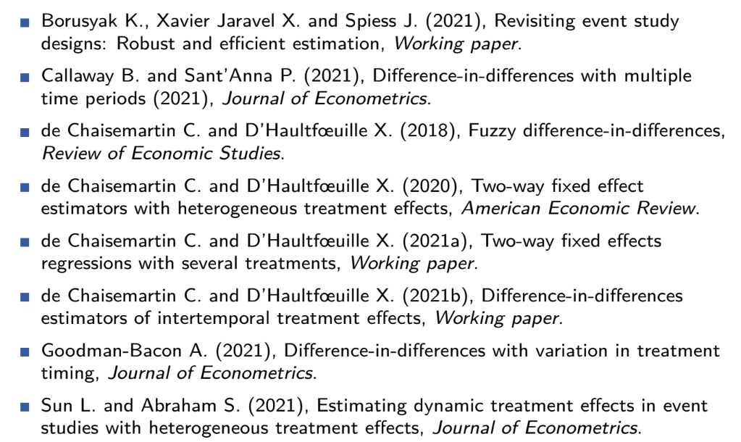
TWFE: A Flurry of Problems (2021)
Notes:
Lots of recent work on the problems of TWFE!

Slide 13
TWFE: A Flurry of Problems (2022)
“Two-way fixed effects and differences-in-differences with heterogeneous treatment effects: A survey” (De Chaisemartin & D'Haultfoeuille)
“Econometrics strikes back: GMM and two-way fixed effects” (Pinzon)
“Estimation of Heterogeneous Treatment Effects Using Quantile Regression with Interactive Fixed Effects” (Ruofan Xu, Jiti Gao, Tatsushi Oka, & Yoon–Jae Whang)
“Interactions in Fixed Effects Regression Models” (Marco Giesselmann & Alexander W. Schmidt-Catran)
“Contamination bias in linear regressions” (Paul Goldsmith-Pinkham, Peter Hull, & Michal Kolesár)
More here: https://asjadnaqvi.github.io/DiD/docs/resources
Notes:
Problems are both getting better and worse as we understand this issue more (it might be in OLS, and PSM? It might be fixable with GMM? This is a rapidly evolving field)

Slide 14
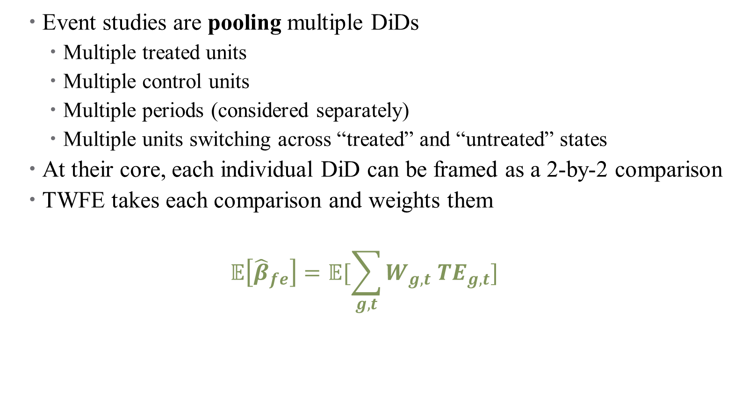
Primary Problem: Weighting
Event studies are pooling multiple DiDs
Multiple treated units
Multiple control units
Multiple periods (considered separately)
Multiple units switching across “treated” and “untreated” states
At their core, each individual DiD can be framed as a 2-by-2 comparison
TWFE takes each comparison and weights them
$$𝔼\left[{\hat{β}}_{fe}\right]=𝔼[\sum_{g,t}{W_{g,t} TE_{g,t}]}$$
Notes:
2x2 comparison of one treated group, one control group, and one pre-/post-period. But TWFE breaks this down so that the control group might be already treated!

Slide 15

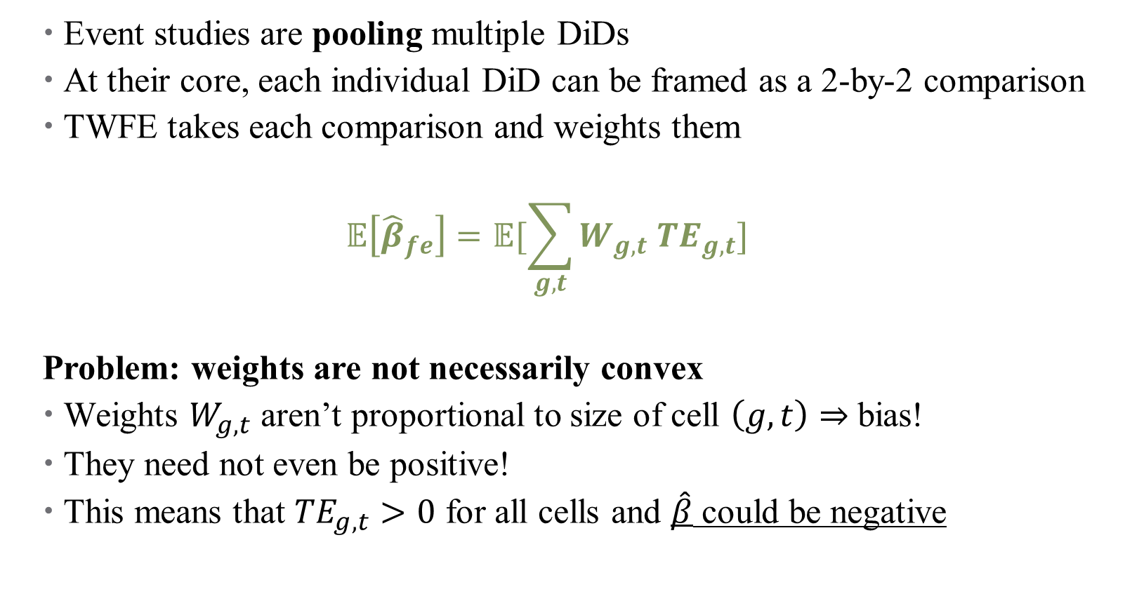
Primary Problem: Weighting
Event studies are pooling multiple DiDs
At their core, each individual DiD can be framed as a 2-by-2 comparison
TWFE takes each comparison and weights them
$$𝔼\left[{\hat{β}}_{fe}\right]=𝔼[\sum_{g,t}{W_{g,t} TE_{g,t}]}$$
Problem: weights are not necessarily convex
Weights $W_{g,t}$ aren’t proportional to size of cell $\left(g,t\right)⇒$ bias!
They need not even be positive!
This means that $TE_{g,t}>0$ for all cells and $\hat{β}$ could be negative
Notes:
Weights kind of come out of nowhere – they don’t match cell sizes, and they aren’t even “weights” in a sense of the word

Slide 16
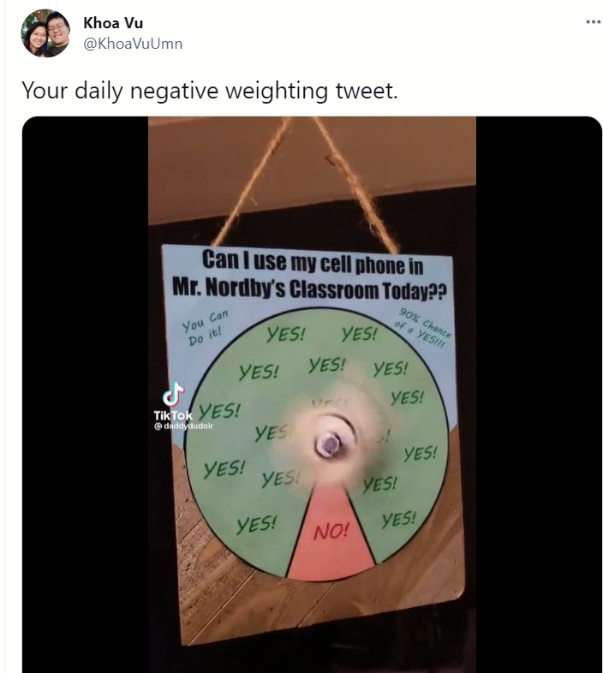
Why is Negative Weighting a Problem?
Notes:
Video demonstration of why negative weighting is a problem (joking – “negative” is down – it’s kind of hard to imagine what a real negative weight would do in data)

Slide 17
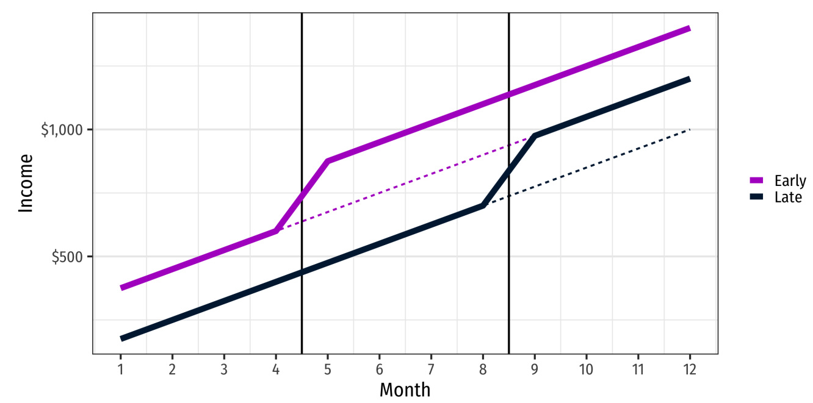
TWFE and Weighting Problems
Notes:
Suppose we have two treated units – one early and one late. Notice that the effect looks the same (and positive) for both groups

Slide 18
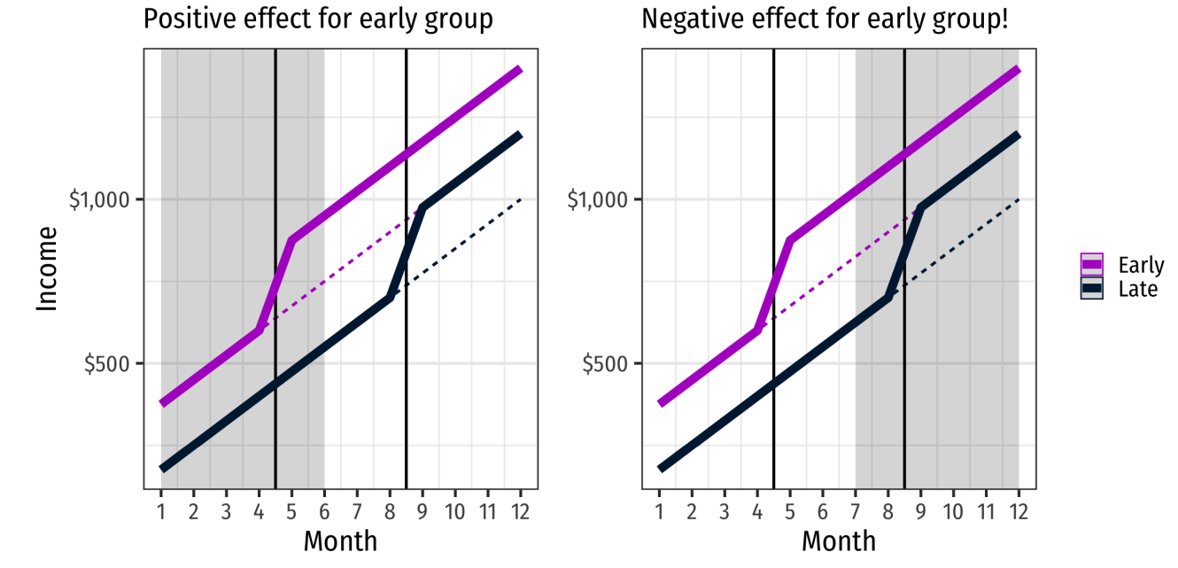
TWFE and Weighting Problems
Notes:
Here, in initial months around treatment for early group (the “post” period), we see positive increase, as expected

Slide 19
TWFE and Weighting Problems
Notes:
Now, think about when we estimate the long-run effects for the early group. Eventually, the late group turns on, so the comparison looks like its returning a negative effect! How would this change the event study? (We would see dynamics that aren’t there). This could be fixed by comparing only treated groups to never-treated, but you have to construct that manually.

Slide 20
Where do Negative Weights Come From?
Goodman-Bacon (2021) shows that event studies conflate two types of two-period DiDs:
Comparing a switching group to an unswitched group (untreated)
Comparing a switching group to an already treated unswitched group
This is where the negative weights come from!
Notes:
Remember each comparison is a 2-by-2 cell, so only two time periods and one control group. .

Slide 21
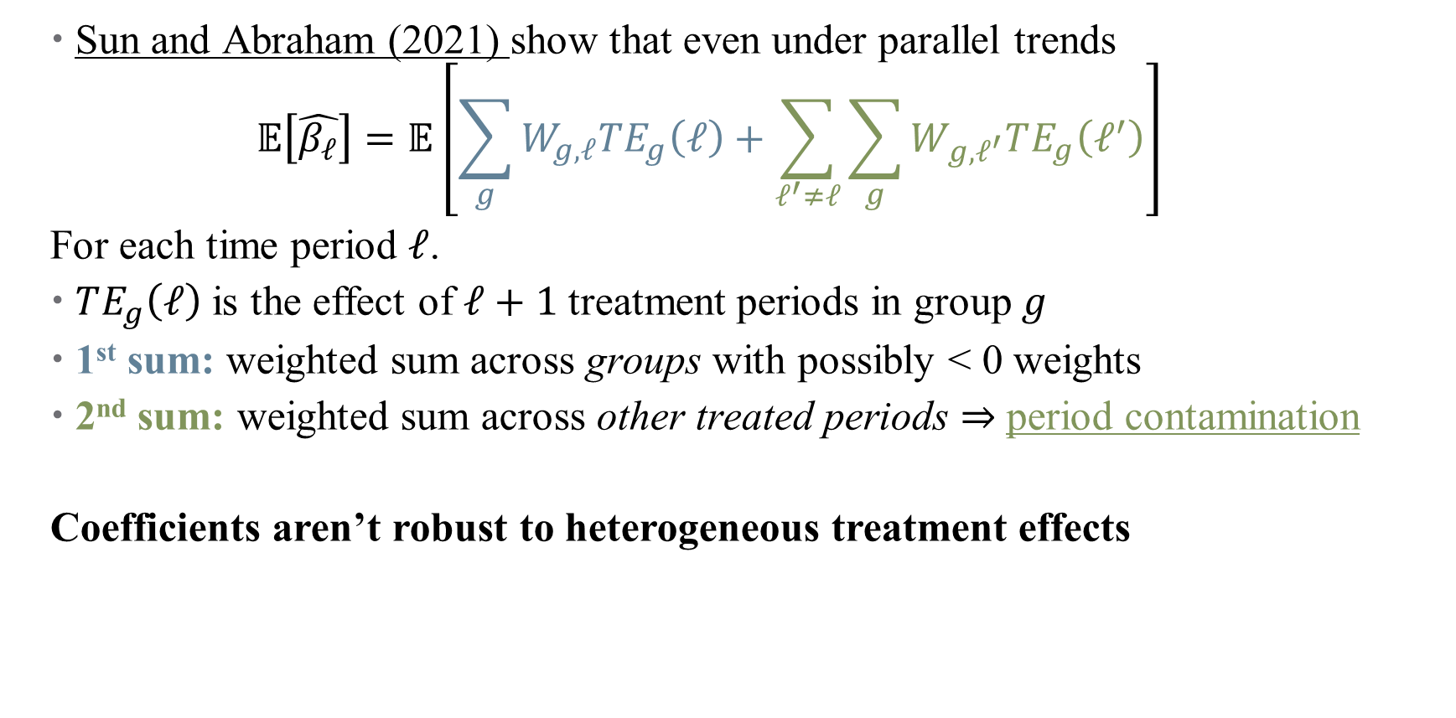
Another Problem: Heterogeneous Treatment Effects
Sun and Abraham (2021) show that even under parallel trends
$$𝔼\left[\hat{β_{ℓ}}\right]=𝔼\left[\sum_{g}{W_{g,ℓ}TE_{g}\left(ℓ\right)+\sum_{ℓ^{′}≠ℓ}{\sum_{g}{W_{g,ℓ^{′}}TE_{g}\left(ℓ^{′}\right)}}}\right]$$
For each time period $ℓ$.
$TE_{g}\left(ℓ\right)$ is the effect of $ℓ+1$ treatment periods in group $g$
1st sum: weighted sum across groups with possibly < 0 weights
2nd sum: weighted sum across other treated periods $⇒$ period contamination
Coefficients aren’t robust to heterogeneous treatment effects
Notes:
Sorry to switch from t to l here. Why ell + 1 – reference group category. This is true even for our pre-trend coefficients. So in summary, two problems: impure 2x2 comparisons, and contamination arising from heterogeneous treatment effects. There’s one more (ID of time Fes separately), but we’ll save that for later.

Slide 22
Alternatives to TWFE
Notes:
Largely comes from Section 3 of the JEL paper by two French authors whose names I really need to learn to pronounce (de Chaisemartin and d'haultfoeuille). Basic approaches are “stacked DID” – you choose your control carefully based on estimand.

Slide 23

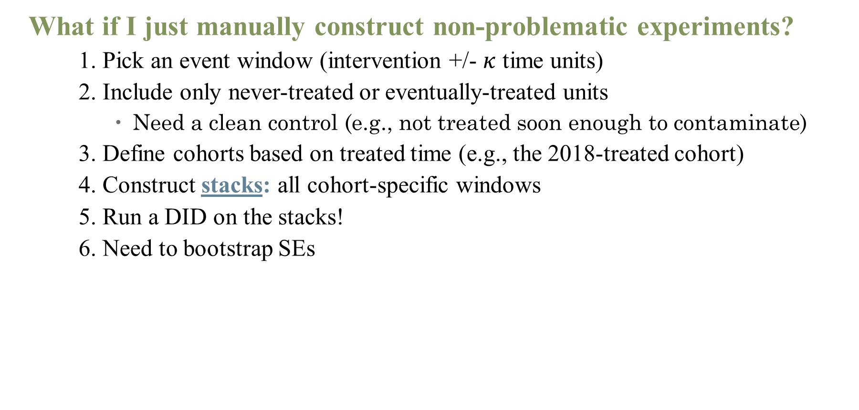
Basic fix: stacks on stacks (on stacks on stacks)
What if I just manually construct non-problematic experiments?
1. Pick an event window (intervention +/- $κ$ time units)
2. Include only never-treated or eventually-treated units
Need a clean control (e.g., not treated soon enough to contaminate)
3. Define cohorts based on treated time (e.g., the 2018-treated cohort)
4. Construct stacks: all cohort-specific windows
5. Run a DID on the stacks!
6. Need to bootstrap SEs
Notes:
Main idea: make sure that we don’t have impre comparisons! Best is to get a control group, then second best is to make a “clean control” based on time window.
Some slides courtesy of Coady Wing (IU). See his slides on inference in the Github repo.

Slide 24
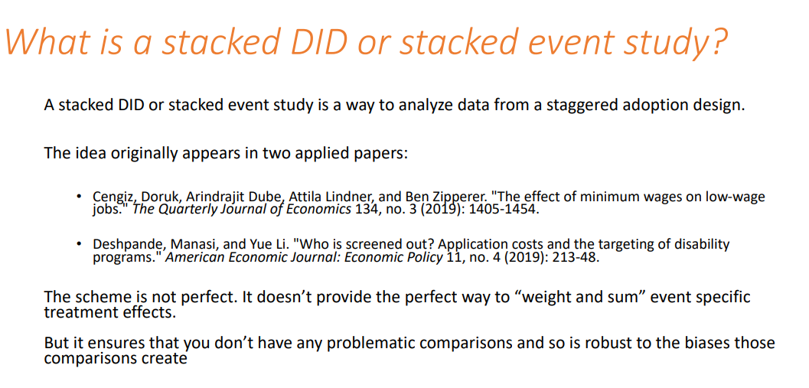
Basic fix: stacks on stacks (on stacks on stacks)
What if I just take out the affected units?
Notes:
Doesn’t get rid of the HTE problem. Also doesn’t allow you to weight and sum perfectly.

Slide 25
Other approaches (broad brush):
Imputation estimators
Fits a TWFE regression in the sample of untreated observations
Uses that regression to predict the counterfactual outcome of treated observations
Most efficient estimation for large samples
Notes:
All estimators here carefully construct comparisons between treatment and control groups that don’t have contamination (unlike TWFE). These are covered in the Github repo.

Slide 26
Other approaches (broad brush):
Imputation estimators
Fits a TWFE regression in the sample of untreated observations
Uses that regression to predict the counterfactual outcome of treated observations
Most efficient estimation for large samples
2. Doubly-robust estimators
Separate models predicting weights (across cells)
Attractive feature: unbiased even if model is misspecified
Also good if you need to condition on covariates for parallel pre-trends
Notes:
Note that here, no “forbidden comparisons” are made.

Slide 27
Other approaches (broad brush):
Imputation estimators
Fits a TWFE regression in the sample of untreated observations
Uses that regression to predict the counterfactual outcome of treated observations
Most efficient estimation for large samples
2. Doubly-robust estimators
Separate models predicting weights (across cells)
Attractive feature: unbiased even if model is misspecified
Also good if you need to condition on covariates for parallel pre-trends
3. Alternatives not covered here:
Randomized timing (Athey and Imbens, 2022; Roth and Sant’Anna, 2021)
Sequential treatment randomization (Bojinov et al., 2021)
Non-binary/multiple treatments (de Chaisemartin and D’Haultfoeuille, 202)
Notes:
Basically, these are all easy to implement. Doubly-robust estimators are seeming to win the horse race (they let you include controls, for example), but may be slower to run in large samples. That’s the main tradeoff as you move forward (come talk to me about these!)

Slide 28
Estimators Everywhere!
did_multiplegt
csdid
did_imputation
eventsutdyinteract
stackedev
did2s
sdid
etwfe
Important question to consider: what is our estimand?
A handy resource: https://asjadnaqvi.github.io/DiD/docs/code/06_twfe/
Notes:
Estimand means: what parameter are we after (e.g., ATT, ATE, something else?) Has good code examples for all relevant estimators

Slide 29
Estimators Everywhere!
did_multiplegt (de Chaisemartin and D’Haultfoeuille, 2020, Imai and Kim, 2021)
csdid (Callaway and Sant’Anna, 2021)
did_imputation (Borusyak et al., 2021; Liu et al., 2021; Gardner, 2021; Wooldridge 2021)
eventsutdyinteract (Sun and Abraham, 2021)
stackedev (Cunningham, 2021; Baker, 2021)
did2s (Gardner, 2021)
sdid (Arkhangelsky et al, 2019)
etwfe (Wooldridge, 2021)
Important question to consider: what is our estimand?
A handy resource: https://asjadnaqvi.github.io/DiD/docs/code/06_twfe/
Notes:
These examples are in the Github repo. Sun and Abraham is very similar to csdid. Stackedev (stacked did) is too transparent as to be inefficient, so less desirable – others have a direct model of counterfactual for untreated observations (PTA) that increases efficiency. Note: did_imputation and did2s are equivalent without covariates, but the did2s package works better/faster in R. synthetic did is newer and may have weaker parallel trends assumptions, but hasn’t really taken off yet.

Slide 30
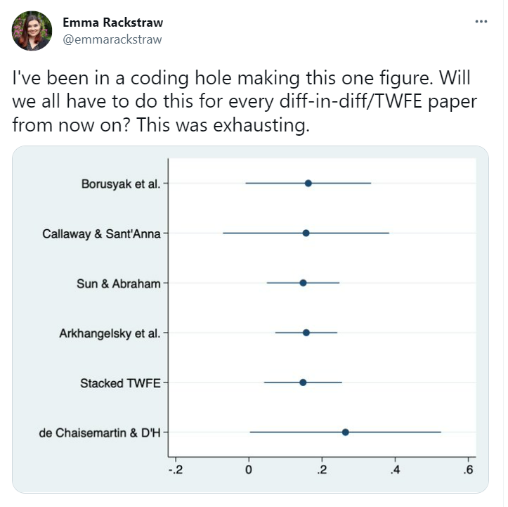
Do I have to run them all?
Notes:
Sometimes it feels (and you might even be asked to) like you have to run every single one of these – don’t! If you can help it.

Slide 31
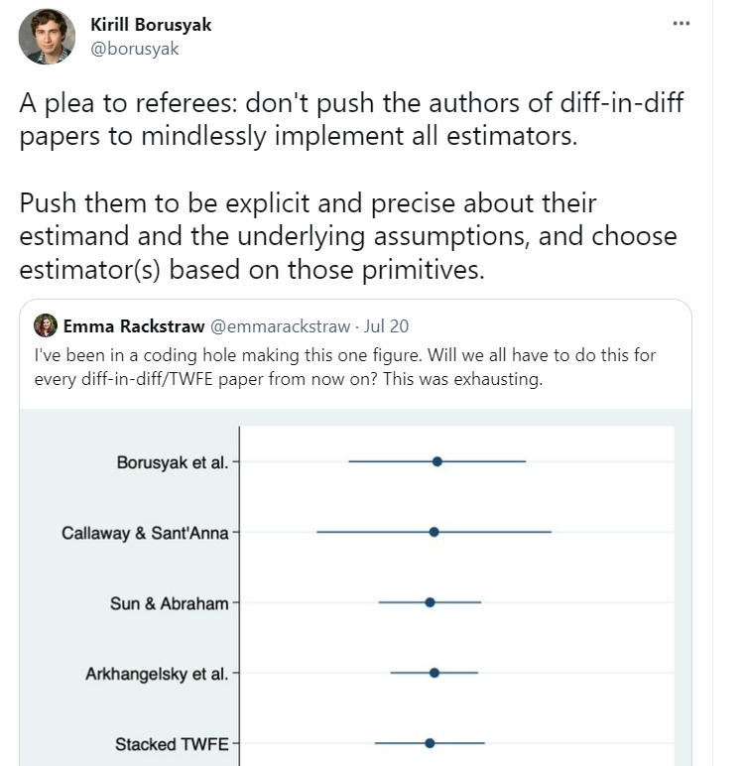
Do I have to run them all?
Notes:
Do this instead. And note: there are extensions if there are multiple treatments, or non-binary (discrete or continuous) treatments. Things get more complicated, of course. There is, of course, a way to put them all together, which I’ll show you just in case you’re referee asks for it.

Slide 32
Health Econometrics I
Lecture 12: Topics in Research Design
December 2, 2022
HAD5744 • Alex Hoagland, Ph.D.

Slide 33

Framework: Everything is a Remix
Notes:
Through part 2. Everything is influenced by previous work (cite it), and don’t be afraid to construct your work as copies + combinations + transformations. This is how innovation occurs!

Slide 34

Everything is a Remix
Read lots of research!
Can even copy language of authors, journals, etc.
Important signaling + helps refine your research for your audience
Sign up for journal eTOCs: JHE, HE, Health Affairs
But don’t read just research!
Some good health newsletters:
Hospitalogy
News: Healthcare Global, Healthcare Dive, Axios Vitals (US)
Substacks: Vital Signs, Waiting Room, Margins of Medicine
Copy, combine, transform
Notes:
Some of my favorites: Amitabh Chandra, Joseph Newhouse, Tal Gross

Slide 35
What are we Estimating?
Notes:
The key innovations lead us to new answers to (sometimes slightly new) questions. One of the most important things to remember from this course – what is your estimand, and is it useful? How? We need to be good stewards of our data and research, and talk accurately about how our research designs give us causal pathways.

Slide 36

Example: What is Long COVID?
Notes:
Based on this study from the Lancet -- A key point about long COVID (and really, all chronic disease) is to remember that the number of people who have the condition is VERY dependent on how we define it

Slide 37
Example: What is Long COVID?
This study:
Large retrospective study (236,000 people who had COVID)
Looks at psychological/neurological symptoms post-COVID infection
Intracranial haemorrhage
Ischaemic stroke
Parkinsonism
Guillain-Barré syndrome
Dementia
Psychotic, mood, and anxiety disorders
Substance use disorder
Etc.
Notes:
This study is BIG – already cited 890 times with an altmetric score of 13.8k. Also included a control group of non-infected, close to 80 million patients. This is big data

Slide 38
Example: What is Long COVID?
This study:
Large retrospective study (236,000 people who had COVID)
Looks at psychological/neurological symptoms post-COVID infection
Matching study between cohorts
Notes:
Here, let’s start thinkin about threats to causality – what are some of the big things to watch out for when you hear matching? (selection on unobservables, type of matching)

Slide 39
Example: What is Long COVID?
This study:
Large retrospective study (236,000 people who had COVID)
Looks at psychological/neurological symptoms post-COVID infection
Matching study between cohorts
Main findings: 34% of people with COVID had at least one symptom
So what is this probability? Is it $P\left(long COVID | COVID infection\right)?$
Notes:
Why or why not? A lot of people said yes! Even a JAMA article citing this study said that this is true! But it’s not! (Not yet – haven’t dealt with *new* diagnoses, for example). Just last week, new study on if COVID caused T1D showed that really, it was T1D “causing” COVID.

Slide 40
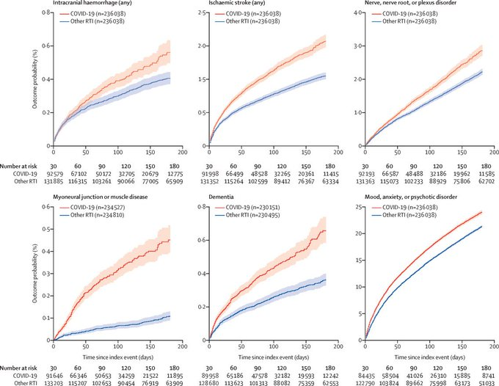
Example: What is Long COVID?
Notes:
What do these effects tell us? Are they economically significant? Are they statistically significant? They sure look bad! But what issues are there? (Publication bais; they’re only showing us 6 here. Plus look at y-axes. And what is the control group here?)

Slide 41
Example: What is Long COVID?
But this conflates:
Exacerbations of existing disease
New diagnoses
Look at $y$-axes: almost all of the effect is from mental health conditions!
Notes:
These include people with an old dx (e.g., depression) who filled a prescription, visited a GP, or went to the hospital for an unrelated issue – is that what we want to capture? The authors answer yes (because we care about flare-ups), but you could also reasonably argue that no, we only care about new onset (or some flareups, but which?)

Slide 42
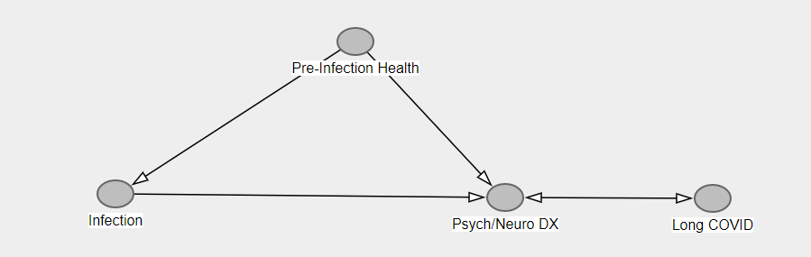
Example: What is Long COVID?
What’s the DAG here?
If we limit to
Notes:
Sample DAG – are we really getting the causal impact of infection to long covid? Maybe, but we haven’t closed back door, nor do we know that these dx’s are long covid (e.g., do we care about insomnia as a problem? Do we care about flare ups)

Slide 43
Example: What is Long COVID?
What’s the DAG here?
If we limit to
If we limit to new diagnoses only, $P\left(new dx | infection\right)=13\%$
But who’s the right control here?
Notes:
This is still matching only to the fully healthy group. But there are 80 million patients, surely we can pick a better match than that?

Slide 44
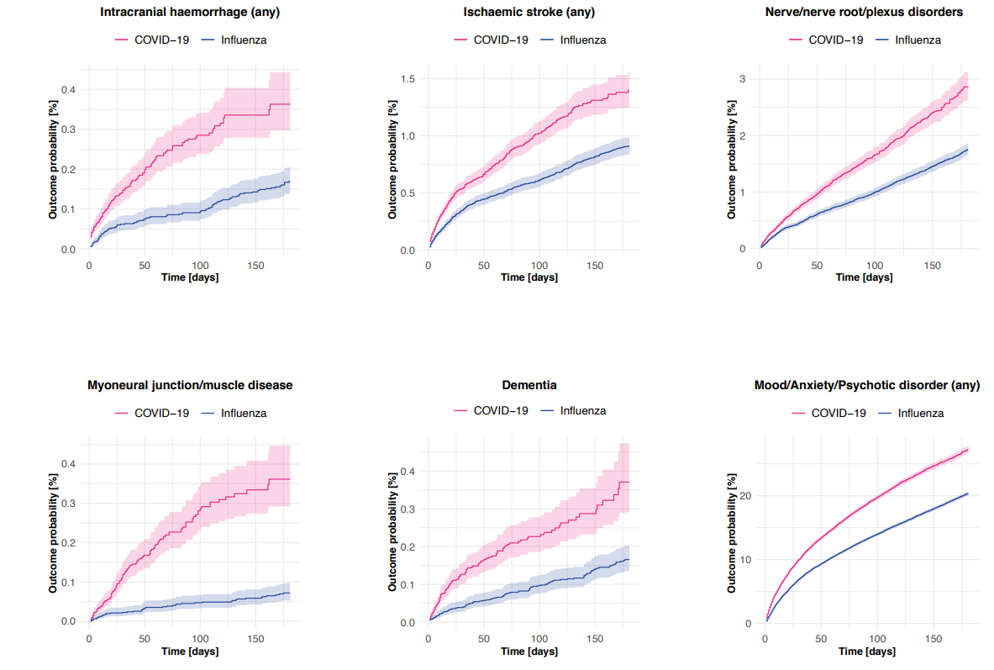
What if you compared to comparable illnesses?
Now, $P\left(DX | I\right)=$ 5%
But 20% of the infections were hospitalized in this sample!
Notes:
Now we’re matching not to the people with no health event, but to people with influenza (or broken bone, etc.). Differences are much smaller! You have to go to the online appendix to even find this! That already says something about the messaging of this article (plus the fact that curves are different, axis are shrunk, etc.). What is the takeaway? About 8% of the control cohorts had any new diagnosis of any of the issues assessed in this paper, compared to around 13% of the people infected with COVID-19.

Slide 45
Example: What is Long COVID?
This doesn’t mean estimates aren’t useful. They just measure different things:
We have $P\left(Any Diagnosis | Infection\right)$compared to fully healthy group
$P(New DX|I)$ compared to fully healthy group
$P(Any DX|I)$ compared to various related health events
$P(New DX|I)$ compared to various related health events
So which one is right?
Notes:
They all are! For different things. What’s your policy context? What’s the threshold for economic significance (even 5% is not trivial)?
These are all things you need to think carefully about and be honest about in a paper. Why is your headline figure what it is? Why did you bury that figure in an online appendix? How will other researchers interpret your results when they cite you? How will the media cite you? Is that what you want?

Slide 46
Selecting a Research Design
Notes:
With this framework of remixing and thinking about your estimand in mind, let’s talk about how to pick a research design?

Slide 47
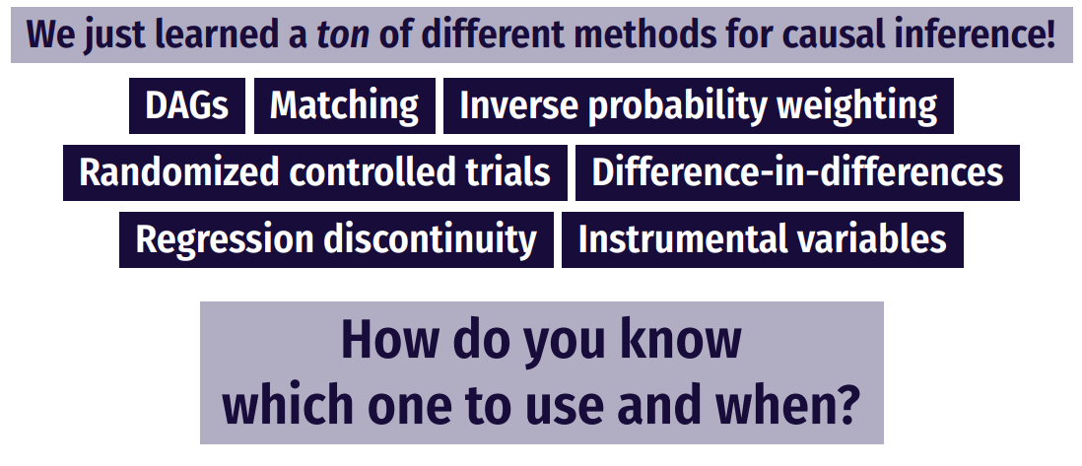
How do you pick a method?

Slide 48
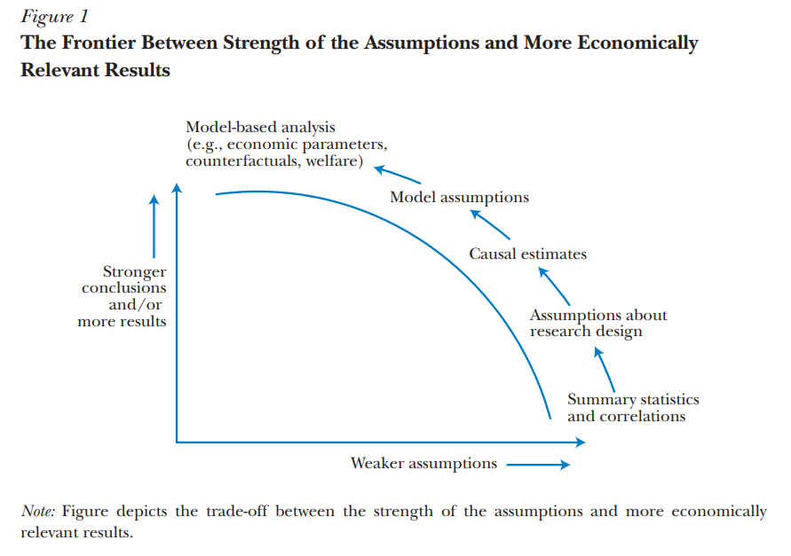
How do you pick a method?
Source: Mahoney (2022)

Slide 49
Relying on Theoretical Frameworks
Almost all frameworks are theories of change (causal pathways)
But how can a framework motivate a design?
Write your research question as explicitly as possible
Draw a DAG! Take time thinking about open back- and front-doors
Maybe build the DAG into a theoretical model
DAG + model $⇒$ Regressions, assumptions, even identification!
Notes:
Building a model may require some calculus to solve it, but provides useful insights into relative comparative statics, what the real parameter of interest is (hint: usually a first/second derivative). Can embed these even further into a structural approach (more on this in a separate course, if there is demand?)

Slide 50
Choosing an Empirical Strategy
Your empirical strategy consists of two (related) components:
Estimation strategy: what is estimated, how, inference, etc.
Put equations in your papers!
Identification strategy: what allows making a causal statement?
Do you have experimental variation?
Balance?
Is there endogeneity in your design?
(reverse causality, heterogeneity, measurement/omitted error)
Notes:
Treat these as separate in your paper! Don’t be scared of regression equations – in fact, formalizing them will help you see threats to identification and improve your estimation approach.

Slide 51
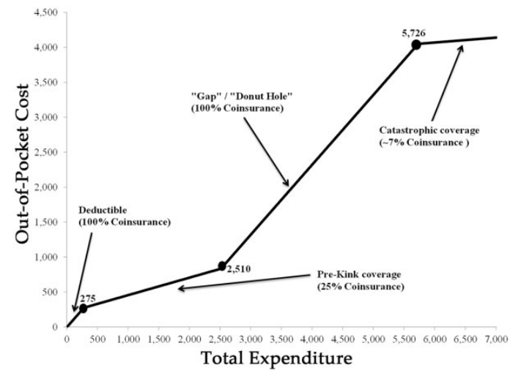
Descriptive Statistics are Your Friend!
1. Tell us something about the “story” you have in mind
Notes:
See “Mere description” in the folder. Even though we’re after a causal pathway, a solid set of descriptive stats (or better, a singl descriptive figure that tells your story) helps you to sell your work before it begins. By descriptives we mean just looking at patterns in the data, not trying to recover causal pathways.
Example: donut hole in Medicare (subsidies before/after a region, but a middle part where you have to pay 100% of expenses) (Einav, Finkelstein, and Schrimpf 2015)

Slide 52
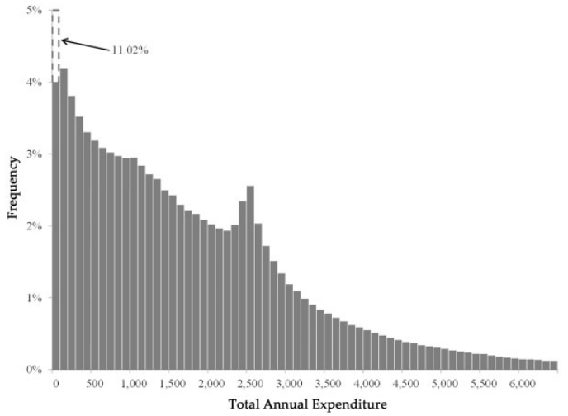
Descriptive Statistics are Your Friend!
Tell us something about the “story” you have in mind
You can argue the variation you’re exploiting in fact exists!
Notes:
In this case, the variation is bunching at the kink of the donut hole

Slide 53
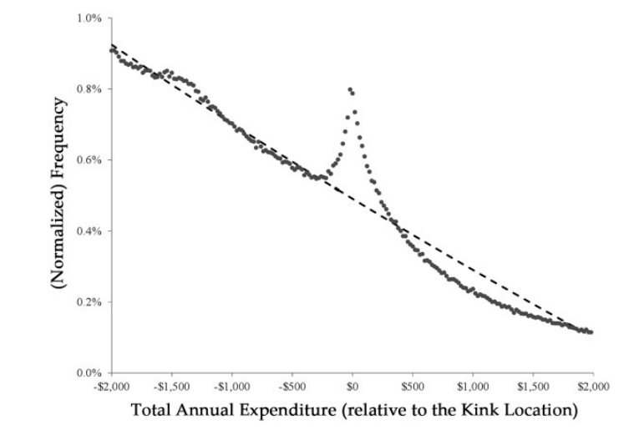
Descriptive Statistics are Your Friend!
Tell us something about the “story” you have in mind
You can argue the variation you’re exploiting in fact exists!
Notes:
In this case, the variation is bunching at the kink of the donut hole

Slide 54
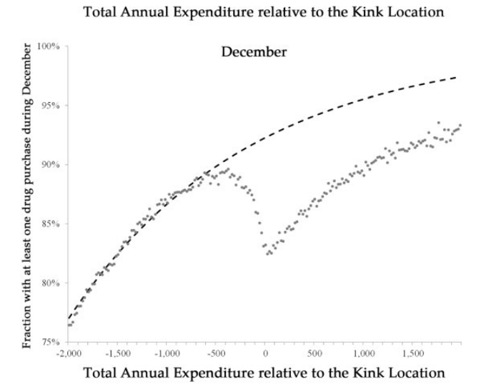
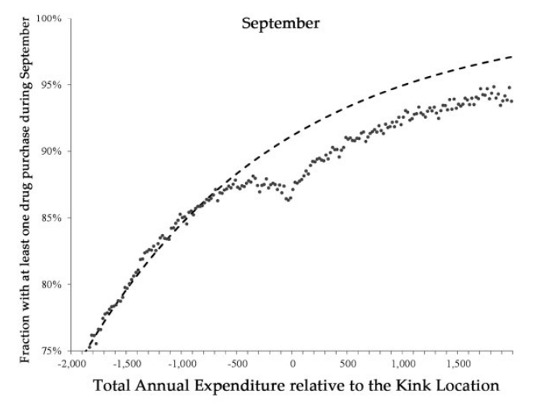
Descriptive Statistics are Your Friend!
Tell us something about the “story” you have in mind
You can argue the variation you’re exploiting in fact exists!
Informs and motivates your model
Notes:
In this case, show that consumers respond before the end of the year, but less than they do at the end of the year (so consumers aren’t fully forward looking). The descriptives provide evidence of a kink, but don’t allow you to quantify it without a causal model – ding ding ding you have a paper!

Slide 55
Descriptive Statistics are Your Friend!
Tell us something about the “story” you have in mind
You can argue the variation you’re exploiting in fact exists!
Informs and motivates your model
Don’t forget to say something about whom your sample is representative
Medicare Part D enrollees
Subject to the donut hole
Close to the kink point (since they are using a bunching strategy)
How does/doesn’t this generalize?
Notes:
Who are we looking at in this case? Seniors with Part D coverage – does that expand to other populations? Maybe, maybe not.

Slide 56
Communicating Findings

Slide 57
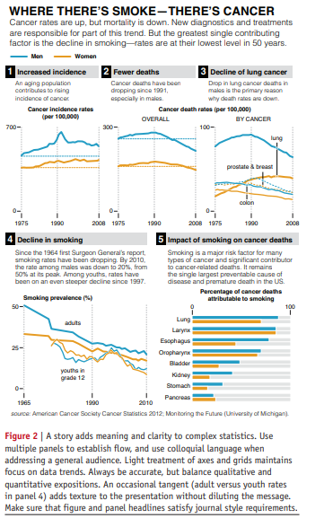
Data Viz
Schwabish (2014):
Show the data
Reduce the clutter
Integrate the text and the graph
See some helpful slides and examples here
Notes:
Figures are the most important thing about a paper – no, really. I think this is why TWFE took off more than anything else – the figures. Read this article in Github repo. How does the data viz stack up to some of these principles

Slide 58
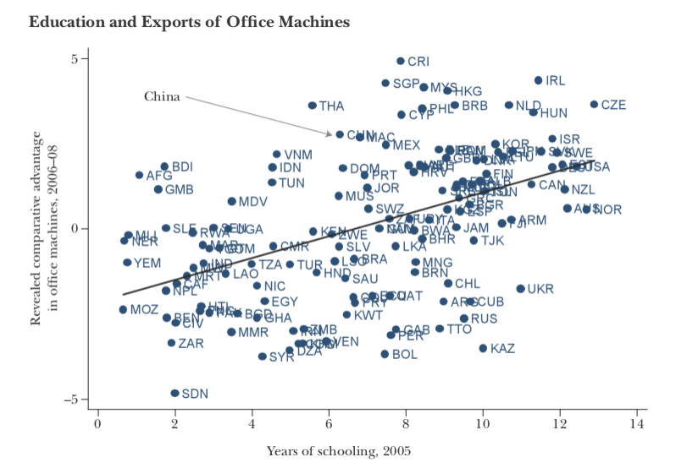
Data Viz: Before (1/2)
Notes:
What are some problems with this? This graph is super easy to make in R – but it pays to take the tmie to clean it up.

Slide 59
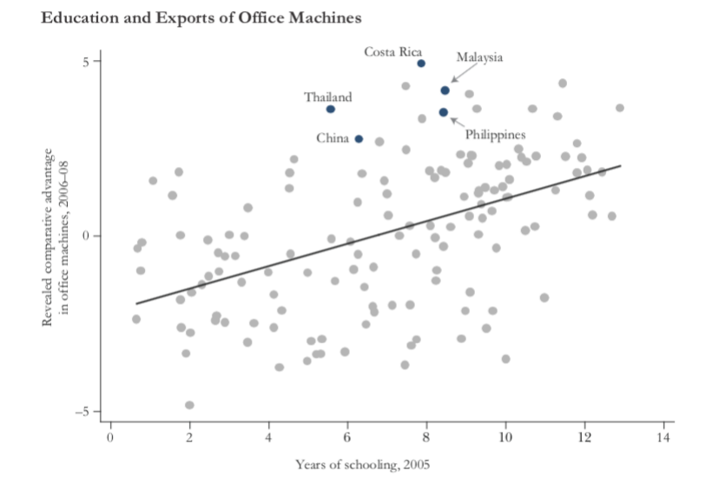
Data Viz: After (1/2)
Notes:
How is this better/ What does it tell us about the paper without reading it?

Slide 60
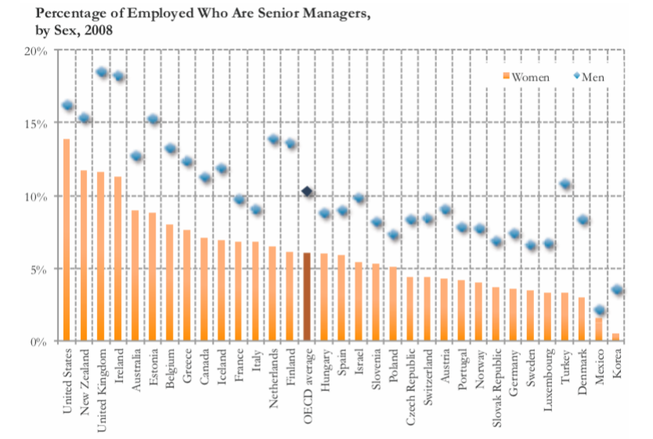
Data Viz: Before (2/2)
Notes:
This chart just doesn’t tell the story we want it to!

Slide 61
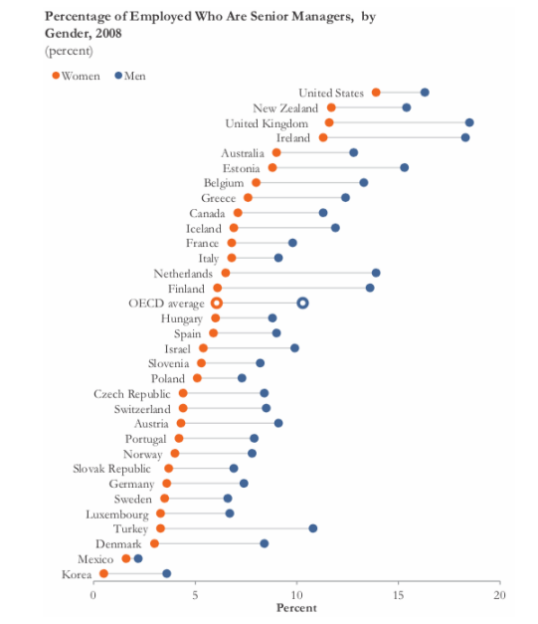
Data Viz: After (2/2)
Notes:
Now what’s the takeaway?

Slide 62

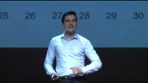
Data Storytelling and Making Good Charts
Notes:
If there’s time, data storytelling ted talks (probably will have to skip). Start with #1 if time.

Slide 63
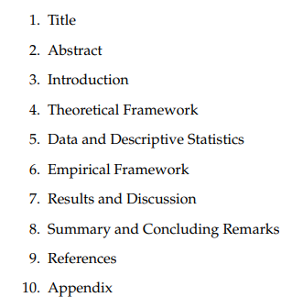
Writing a Paper
Academic writing is formulaic – take advantage of that!
Notes:
Follow the outlines!

Slide 64
Writing a Paper
Academic writing is formulaic – take advantage of that!
Copy good writers
Prioritize good writing – it will make your papers more successful
Some other good sources:
Marc Bellemare “How to Write an Applied Economics Paper”
Neil Mahoney “Principles for Combining Descriptive and Model-Based Analysis in Applied Microeconomics Research”
Notes:
What’s more, just copy structures of papers you think are good (literally – table 1 does X, etc.) This both makes your writing better and makes it easier for reviewers.

Slide 65
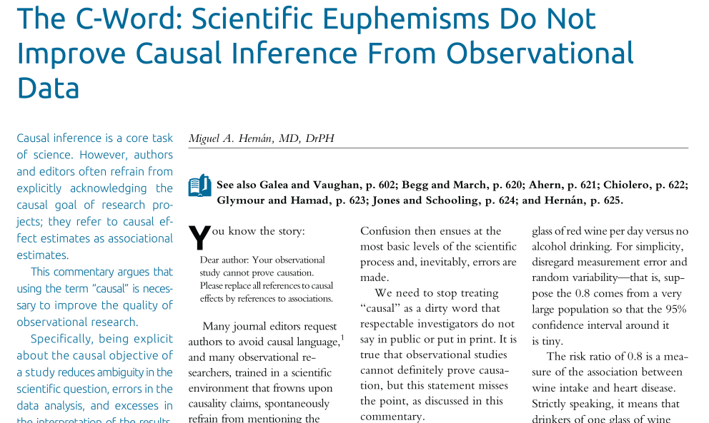
Concluding Thoughts
Don’t be afraid of causal inference!
In particular, don’t go back to saying everything you study is “associations”
Notes:
Fight the power!

Slide 66
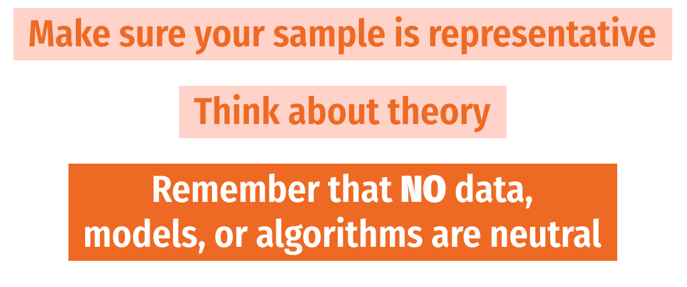
Concluding Thoughts
Don’t be afraid of causal inference!
In particular, don’t go back to saying everything you study is “associations”
And don’t be afraid of R!
Think carefully about your research setting
Notes:
Think carefully about how your results are going into the world. What are the assumptions? Limitations? External validity? What biases are you perhaps missing?

